Slide 1
Some Cool Title
Some Link
Some Link
Some Link
Some Link
I’m a table
Cool?
Maybe not.
Maybe it is.
This is to list problems.
Or courses.
Or profs.
Or whatever.
I’m tired.
XGene 360
This is a viewing panel.
View what?
Histograms, graphs, instructions …
It’s a shape-within-a-shape.
I need it like that.
An image has a border like so.
The inner border is the same color
as background
Then you have black outline.
Table Name
This is for login table and stuff
Something:
Instructions:
Generation information and instructions go here.
Notes:
Every panel will load an image of a sort as a background. If anyone can think of something better than fine. I’ll try to make the images light so loading would be fast.
Should the grid be an image or not? Or a table?
The table borders will be gradient, and they would probably be smaller.

Slide 2
Some Cool Title
Some Link
Some Link
Some Link
Some Link
I’m a table
Cool?
Maybe not.
Maybe it is.
This is to list problems.
Or courses.
Or profs.
Or whatever.
I’m tired.
XGene 360
This is a viewing panel.
View what?
Histograms, graphs, instructions …
It’s a shape-within-a-shape.
I need it like that.
An image has a border like so.
The inner border is the same color
as background
Then you have black outline.
Table Name
This is for login table and stuff
Something:
Instructions:
Generation information and instructions go here.
Notes:
This version is color-coded to show the hierarchy, well, sort of at least.

Slide 3
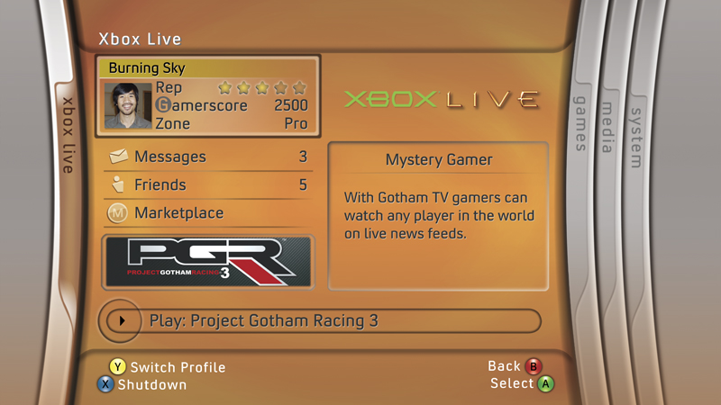
General Idea of Format, Except in Green! Burning Sky Box Used!

Slide 4
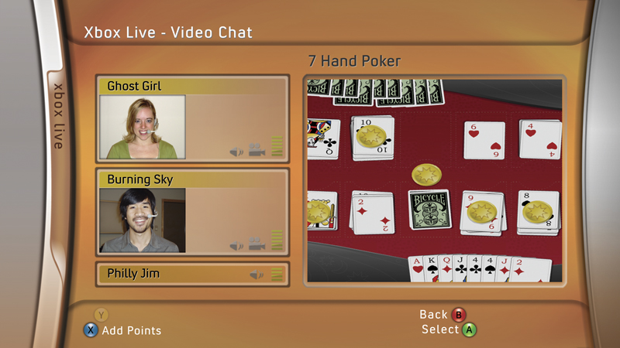
Neat Layout for Student Plant Generation. Left = Histograms. Right = Grid. Bottom = Instructions and Buttons

Slide 5

Left Buttons as Example of Link Buttons

Slide 6
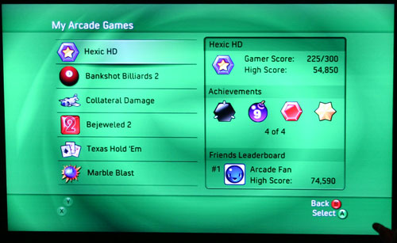
Right Table for Generation Options (Students)? General Color Scheme Too!

Slide 7
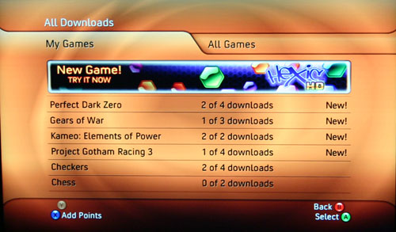
Example of Table

Slide 8
Login Screen
Welcome to XGene 360!
Login
User:
Password:
OK
<Acknowledgements go here>
Notes:
Perhaps have a login place like WebCT or SSC.

Slide 9
Create Student Account
Create Student Account
First Name:
Last Name:
Student Number:
Create Account
- OR -
Upload File:
[Help?]
Browse…
Start Batch Job
Notes:
Generate ID number for student.

Slide 10
Create Problem
Create Problem
Problem ID: 316
Problem Name:
Start Date:
Due Date:
Course:
# of Plants Generated:
# of Plants Displayed:
% Range of Acceptance:
Trait A:
Trait B:
Mean of P1:
Mean of P1:
Mean of P2:
Mean of P2:
SD of P1:
SD of P1:
SD of P2:
SD of P2:
Base Value:
Base Value:
Unit:
Unit:
h²:
h²:
# of Genes:
# of Genes:
Clear
Cancel
Create Problem
Notes:
Trait A and Trait B h2 values will correlate.
The traits can be renamed accordingly.
Don’t forget: “Not all fields have been filled properly!”
Templates?

Slide 11
Professor: View Problem List
Hi <Professor Name>!
Here is a list of problems assigned to you:
Problem
Course
Start Date Due Date
Options/Views
#316: Trait A and B BIOL334 05/01/06 10/01/06
Change Problem
View Students
#341: Trait C and D BIOL334 16/01/06 25/01/06
Change Problem
View Students
Notes:
Courses need to be added separately, maybe a drop-down box.

Slide 12
Professor: View Student Results
Student: John Doe
Student ID: 00000000
Problem: 316
Due Date: 10/01/06
Problem Solution:
% Range of Acceptance: 20%
Trait A: Height
Mean of P1: 40 cm 5%
Mean of P2: 50 cm 1%
SD of P1: 5 cm 50%
SD of P2: 4 cm 20%
h2: 25 20%
# Factors: 12 10%
Trait B: Blue
Mean of P1: 25% 15%
Mean of P2: 45% 10%
SD of P1: 12% 80%
SD of P2: 10% 60%
h2: 10 0%
# Factors: 15 20%
Student Solution:
Trait A: Height
Mean of P1: 39.2 cm
Mean of P2: 50.2 cm
SD of P1: 2.5 cm
SD of P2: 3.5 cm
h²: 20
# of Effective Factors: 10
Trait B: Amount of blue
Mean of P1: 30%
Mean of P2: 40%
SD of P1: 2.5%
SD of P2: 3.5%
h2: 10
# of Effective Factors: 12
Upload Feedback:
Browse…
Student File Report:
View Report
Back
Send Feedback
Notes:
Seeing solutions.

Slide 13
Student: View Problem List
Hi <Student Name>!
Here is a list of problems assigned to you:
Problem
Course Start Date
Due Date
Recent Iteration
Problem Solution
#316: Trait A and B BIOL334 05/01/06 10/01/06 [21/30]
Edit
Hand In
#341: Trait C and D BIOL334 16/01/06 25/01/06 [11/30]
Edit
Hand In
Notes:
This is the first page they see …

Slide 14
Student: Read Problem
Student: John Doe
Student ID: 00000000
Problem: 316
Due Date: 10/01/06
Iteration: 0/30
Instructions:
System Status:
Wait until generation is created …
Generated 1000 plants …
Chosen 100 plants …
Graphed histograms …
Creating next generation …

Slide 15
Student: Select Plants
Student: John Doe
Student ID: 00000000
Problem: 316
Due Date: 10/01/06
Iteration: 1/30
Instructions:
System Status:
1. Select an area on left histogram to
select plants.
2. Select an area on right histogram to
select plants
3. Press ‘Breed’ to breed plants.
Generated 1000 plants …
Chosen 100 plants …
Graphed histograms …
Generated 1000 plants …
Chosen 100 plants …
Waiting …
Breed
View/Select from History

Slide 16
Student: View History
Student: John Doe
Student ID: 00000000
Problem: 316
Due Date: 10/01/06
Generation History
Iteration
Parents
Histograms
Details
1/30
View Parents
View Generation State
2/30
View Parents
View Generation State
Notes:
This is the first page they see …

Slide 17
Student: Edit Solution
Student: John Doe
Student ID: 00000000
Problem: 316
Due Date: 10/01/06
Iteration: 30/30
Edit Solution:
Trait A:
Trait B:
Mean of P1:
Mean of P1:
Mean of P2:
Mean of P2:
SD of P1:
SD of P1:
SD of P2:
SD of P2:
h²:
h²:
Instructions:
# of Genes:
# of Genes:
1. Fill in blanks with answers.
2. Upload a file report for evaluation.
Upload File Report:
Browse…
View History
Save
Hand In

Slide 18
Student: View Results
Student: John Doe
Student ID: 00000000
Problem: 316
Due Date: 10/01/06
Problem Solution:
% Range of Acceptance: 20%
Trait A: Height
Mean of P1: 40 cm 5%
Mean of P2: 50 cm 1%
SD of P1: 5 cm 50%
SD of P2: 4 cm 20%
h2: 25 20%
# Factors: 12 10%
Trait B: Blue
Mean of P1: 25% 15%
Mean of P2: 45% 10%
SD of P1: 12% 80%
SD of P2: 10% 60%
h2: 10 0%
# Factors: 15 20%
Student Solution:
Trait A: Height
Mean of P1: 39.2 cm
Mean of P2: 50.2 cm
SD of P1: 2.5 cm
SD of P2: 3.5 cm
h²: 20
# of Effective Factors: 10
Trait B: Amount of blue
Mean of P1: 30%
Mean of P2: 40%
SD of P1: 2.5%
SD of P2: 3.5%
h2: 10
# of Effective Factors: 12
Student File Report:
Student Evaluation:
View Report
View Evaluation
Back
OK
Notes:
Seeing solutions.

